Slide 1
JD-VRTAC POSTER SESSIONS
Promising and Emerging Job-Driven Models & Strategies: JD-VRTAC Cohort 1

Slide 2
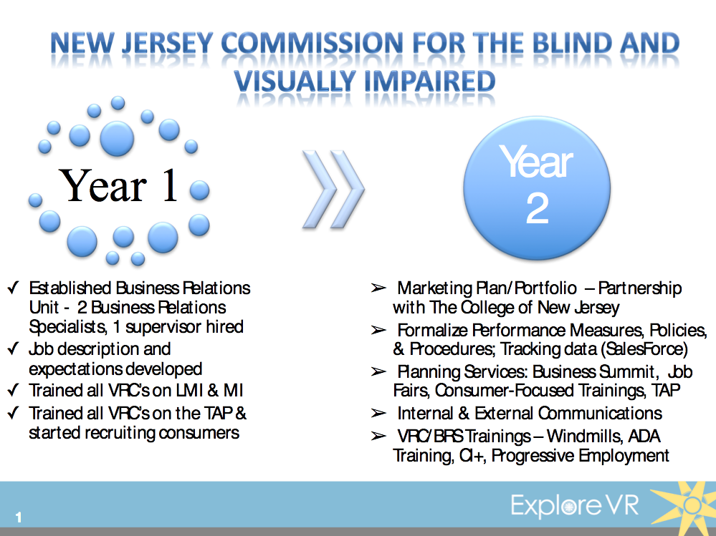

Slide 3
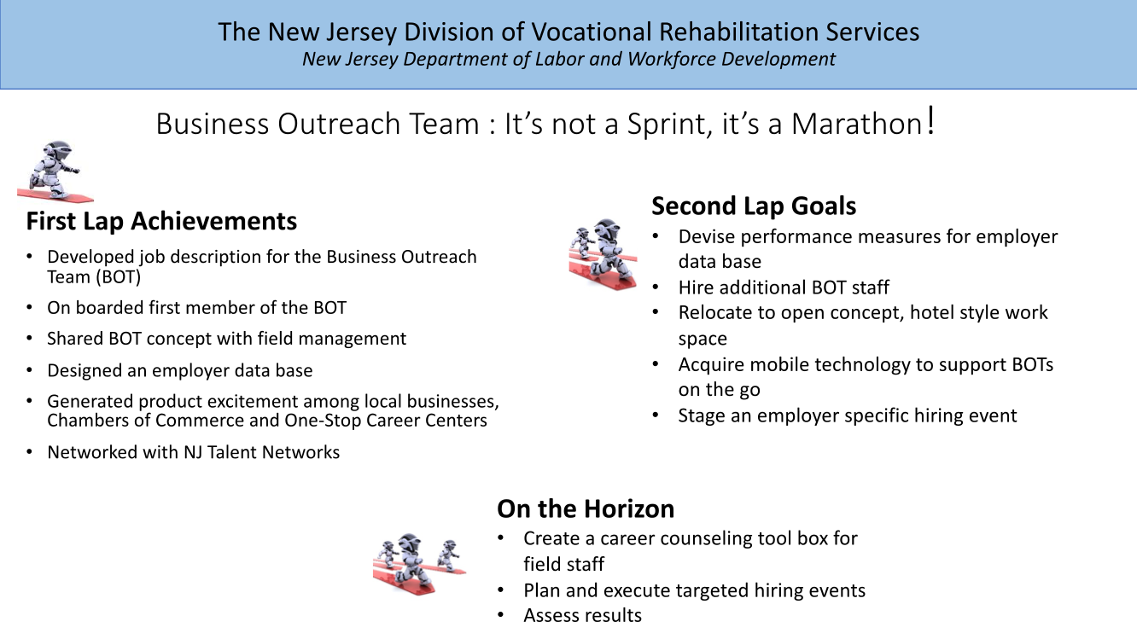

Slide 4
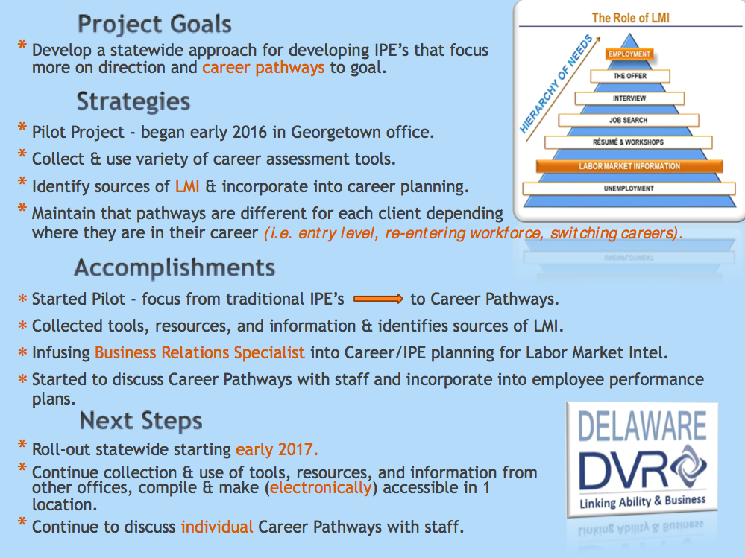

Slide 5
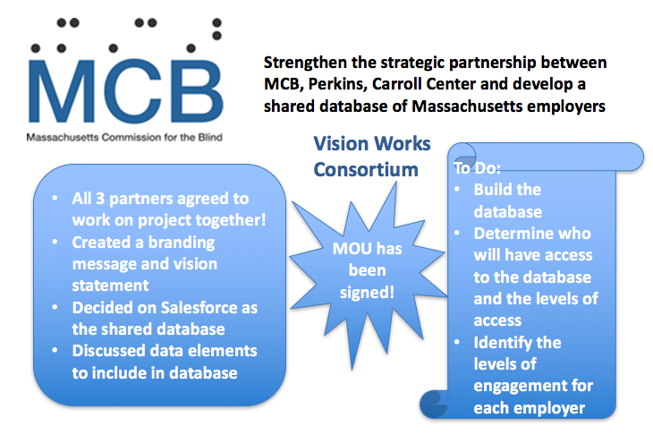

Slide 6
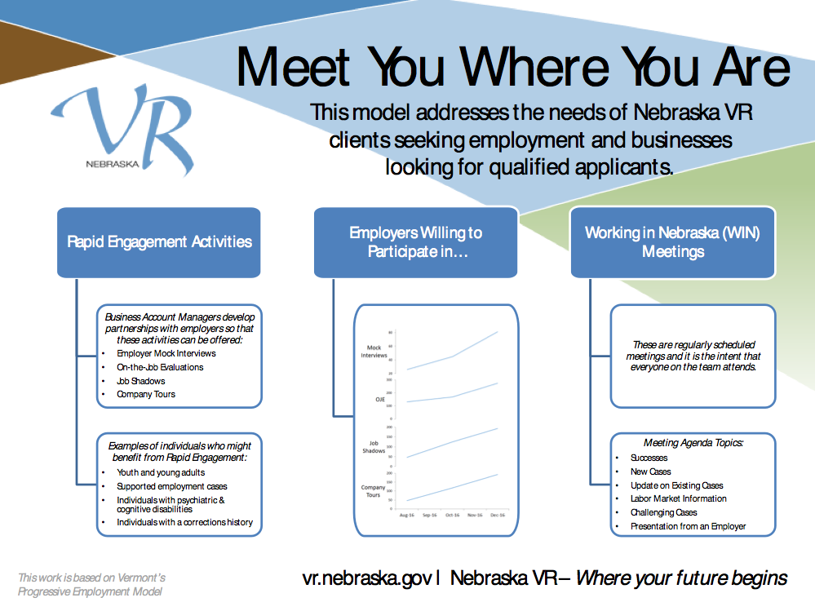

Slide 7


Slide 8
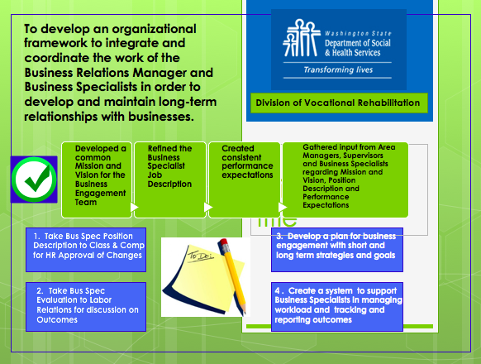

Slide 9
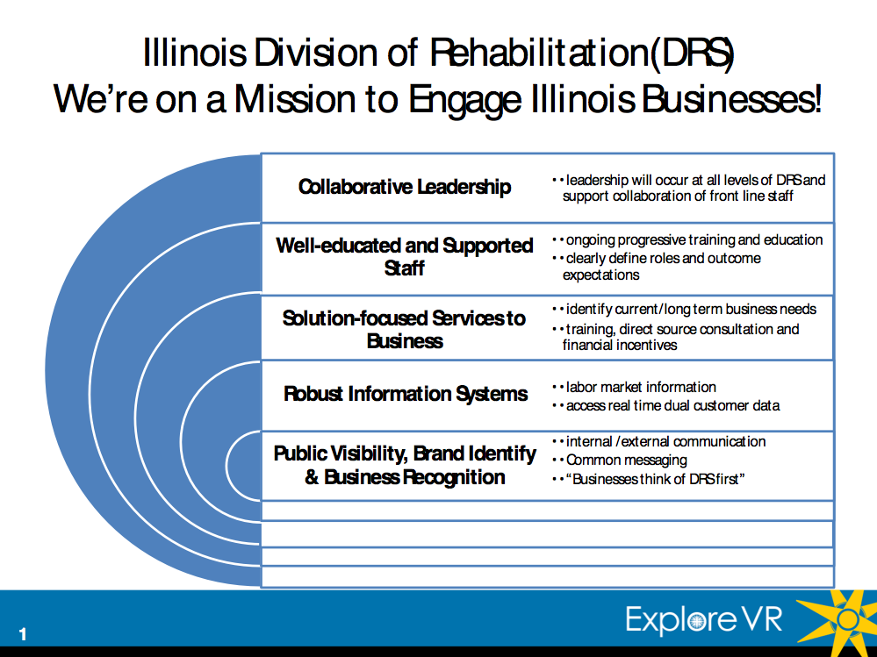

Slide 10
